Slide 1
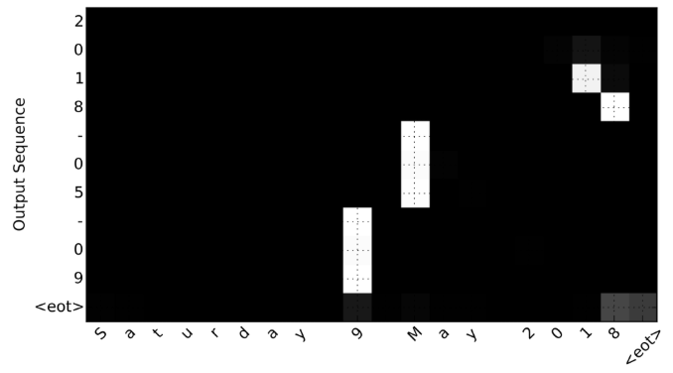
Deep Learning for NLP: TEXT TRANSLATION
Jay Urbain, PhD
Professor, Electrical Engineering and Computer Science Department
Milwaukee School of Engineering
urbain@msoe.edu
July 2018

Slide 2
Neural Machine Translation
Neural Machine Translation (NMT) is typically used to translate sentences from a source language (e.g. Arabic) to a target language (e.g. Hindi), however NMT has a wide range of applications.

Slide 3
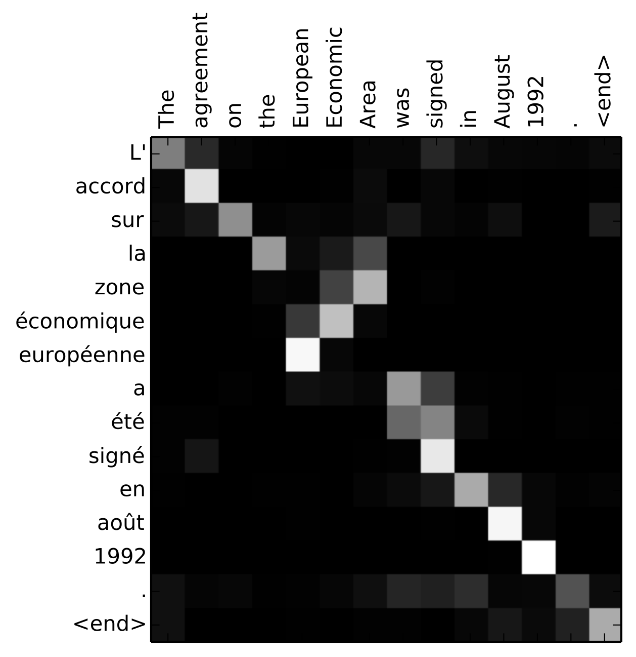
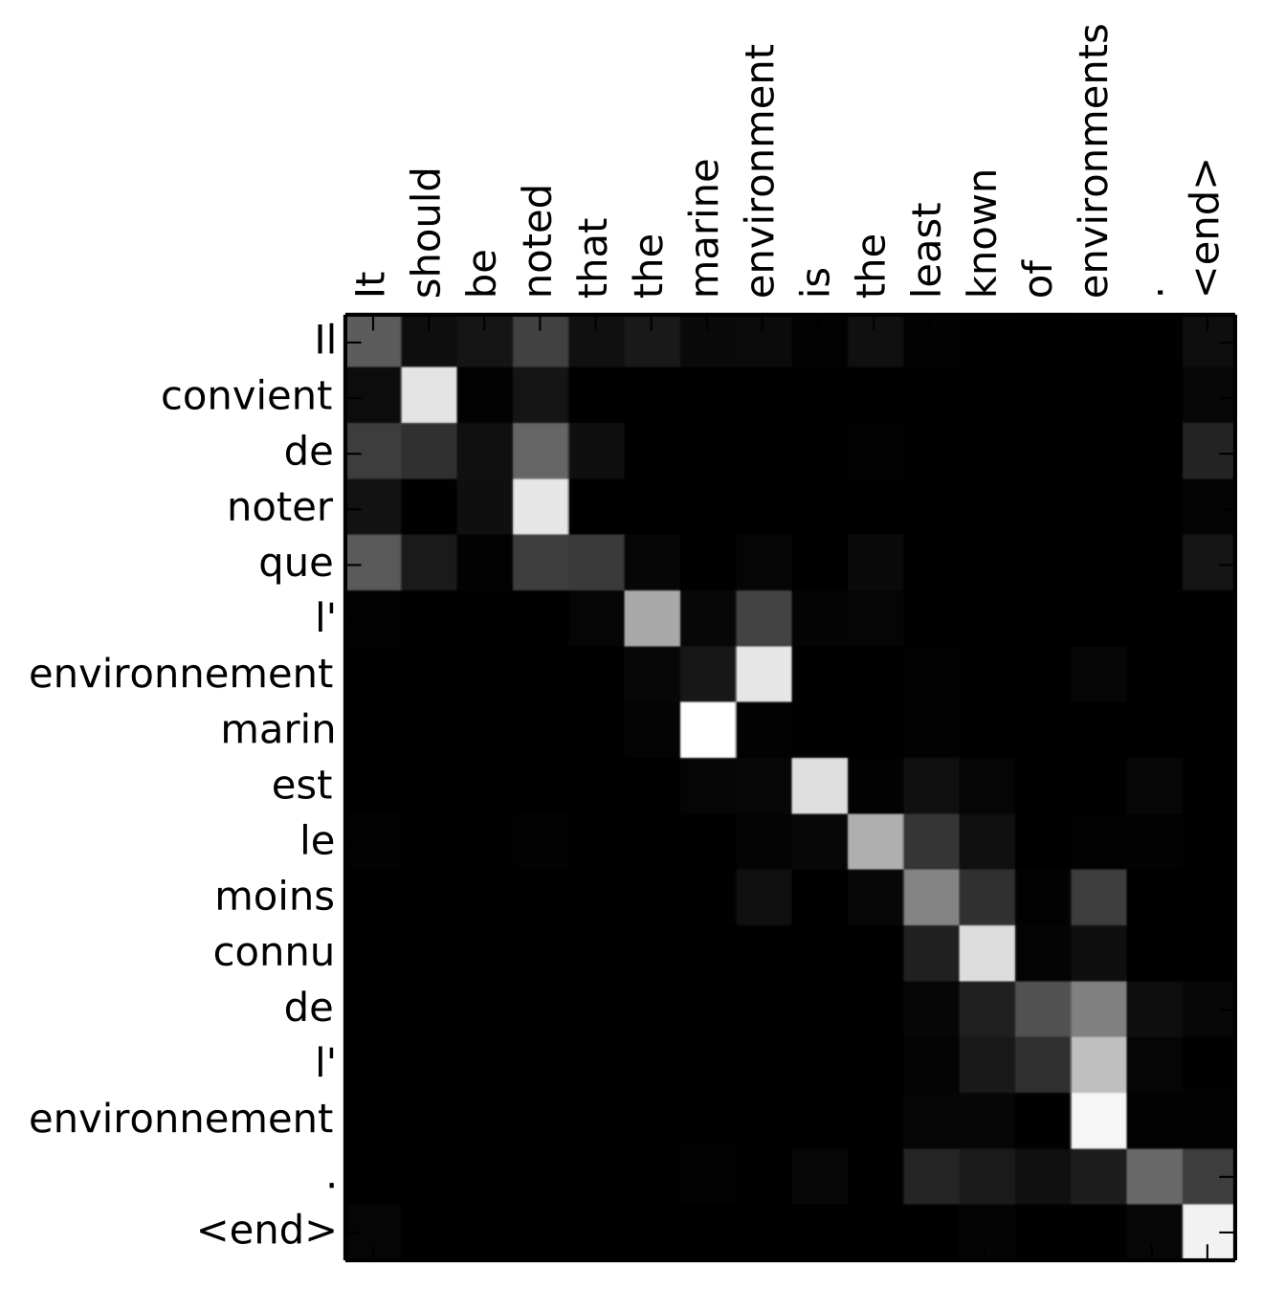
Neural Machine Translation
source language (English)
source language (English)
target language (French)
target language (French)

Slide 4
Neural Machine Translation
We’re going build an NMT model to translate human readable dates.
Example: "the 29th of August 1958", "03/30/1968", "24 JUNE 1987") into machine readable dates (e.g. "1958-08-29", "1968-03-30", "1987-06-24").
We'll be standardizing the dates on the US date encoding of MM/dd/YYYY when generating the dates. The machine readable format is in YYYY-MM-dd format.

Slide 5
Encoder-Decoder Model: ENCODER
A preprocessed source date is encoded using a Bi-directional LSTM.
The sequence of hidden states are returned and stored in an object called enc_out.

Slide 6
Encoder-Decoder Model: DECODER
First, a preprocessed source date is encoded using a Bi-directional LSTM. The sequence of hidden states are returned and stored in an object called enc_out. enc_out is then given as an input sequence to the decoder.

Slide 7
ATTENTION
Intuition:
If you had to translate a book's paragraph from French to English, you would not read the whole paragraph, then close the book and translate.
You would first read the paragraph. Then, while translating, you would read and focus on the parts of the paragraph corresponding to the parts you are currently translating.
Attention mechanism is a technique in Deep Learning to help the model drive its focus onto important parts of the input.

Slide 8
ATTENTION
Intuition:
If you had to translate a book's paragraph from French to English, you would not read the whole paragraph, then close the book and translate.
You would first read the paragraph. Then, while translating, you would read and focus on the parts of the paragraph corresponding to the parts you are currently translating.
Attention mechanism is a technique in Deep Learning to help the model drive its focus onto important parts of the input.

Slide 9
ATTENTION
After running a source date in the encoder (Bi-LSTM), you would like to give all the hidden states to the decoder to get back the target date.
However, at every step in the decoding process, you'd like your model to be able to tell which hidden state is more important to use.
So, inserting the attention block between encoder and decoder is the new architecture we will use to decipher the important parts of the input to pay attention to.

Slide 10
The attention block takes the outputs from the encoder, and applies different weights to them with tanh as the activation function.
Softmax will choose the most relevant vector and apply attention to that output from the encoder.

Slide 11
The attention block takes the outputs from the encoder, and applies different weights to them with tanh as the activation function.
Softmax will choose the most relevant vector and apply attention to that output from the encoder.

Slide 12
LAB DISCUSSION / OVERVIEW

Slide 13
LAB PROCESS
Build and evaluate the simple NMT, then NMT with attention:
Visual network architecture
Train model
Compare test, validation and training accuracy
Attempt to improve the model

Slide 14
ATTENTION MAPS IN TRANSLATION
source language (English)
source language (English)
target language (French)
target language (French)
Bahdanau et al. "Neural Machine Translation by Jointly Learning to Align and Translate", 2014

